Slide 1

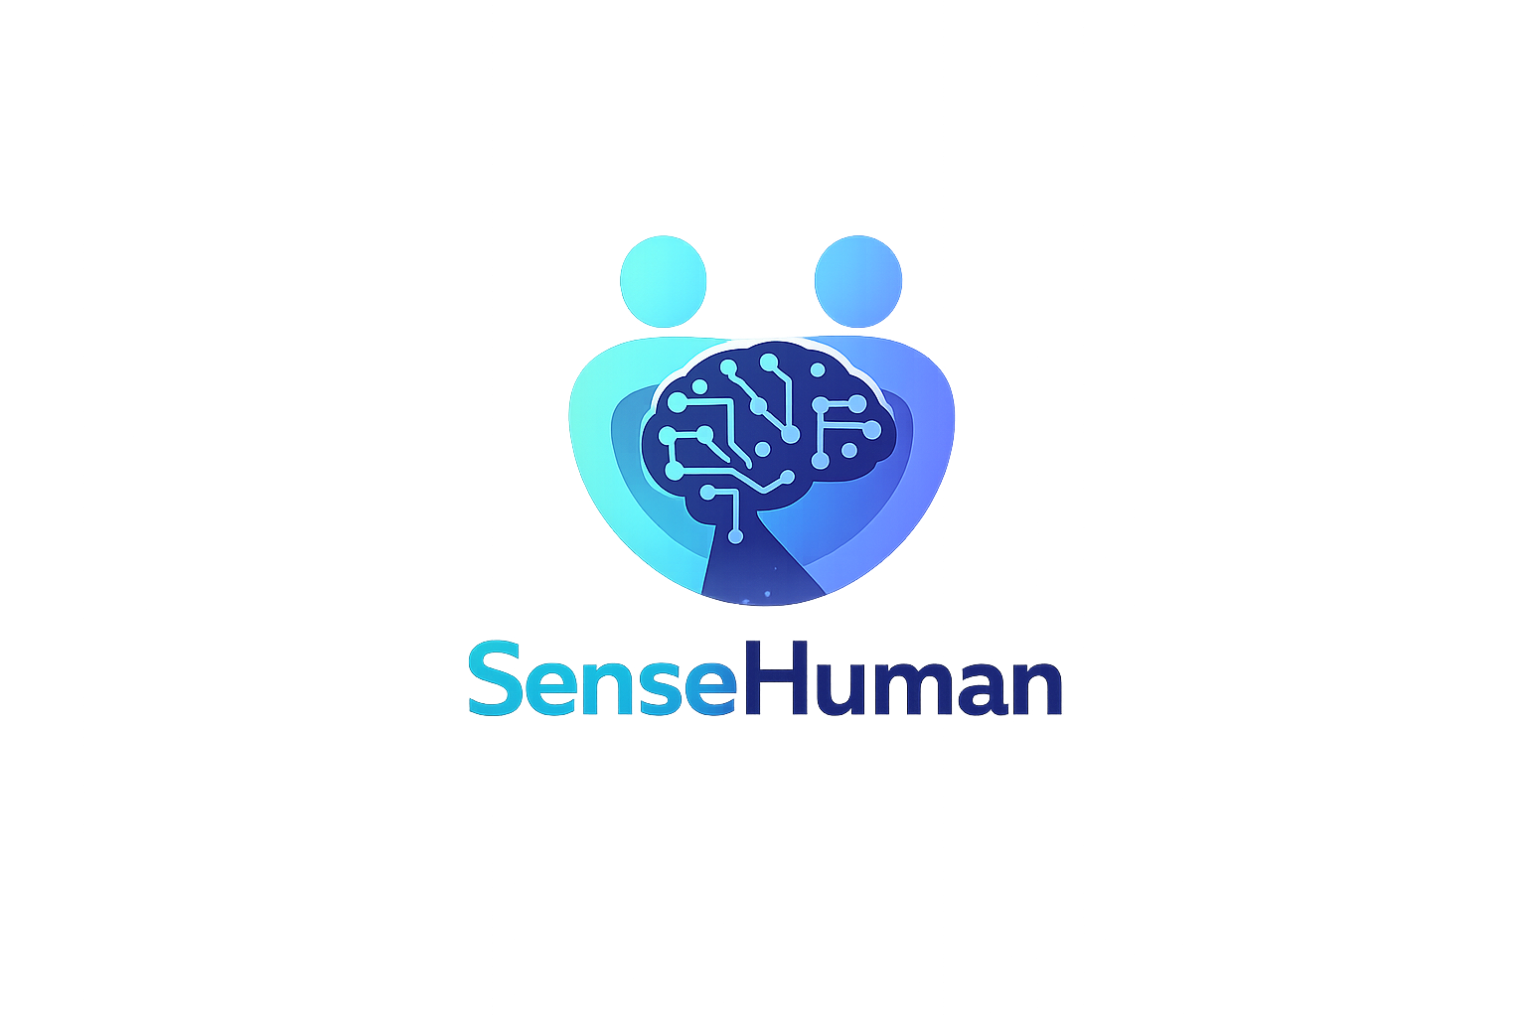
AI-based system designed to support clinical decision making
Notes:
Hello, we will present our project, which we call SenseHuman.

Slide 2
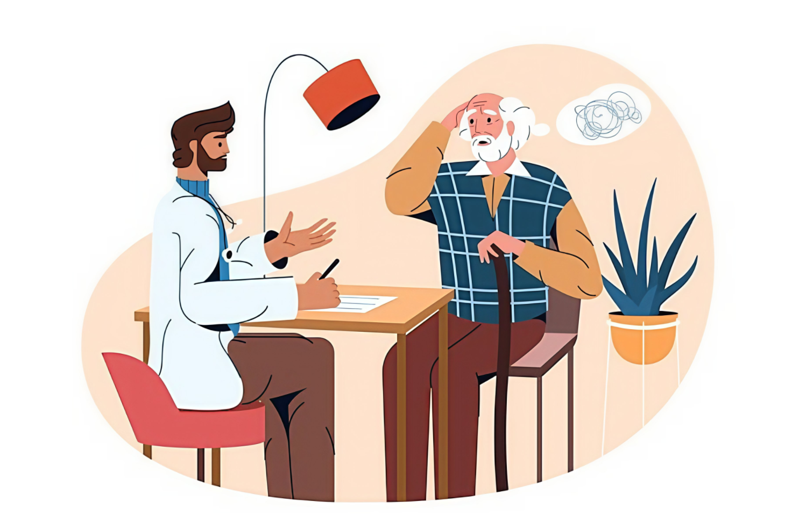
The Problem
Doctor visits are often short
- Symptoms happen at home every day
Wearable data rarely reaches healthcare in a useful way

Slide 3
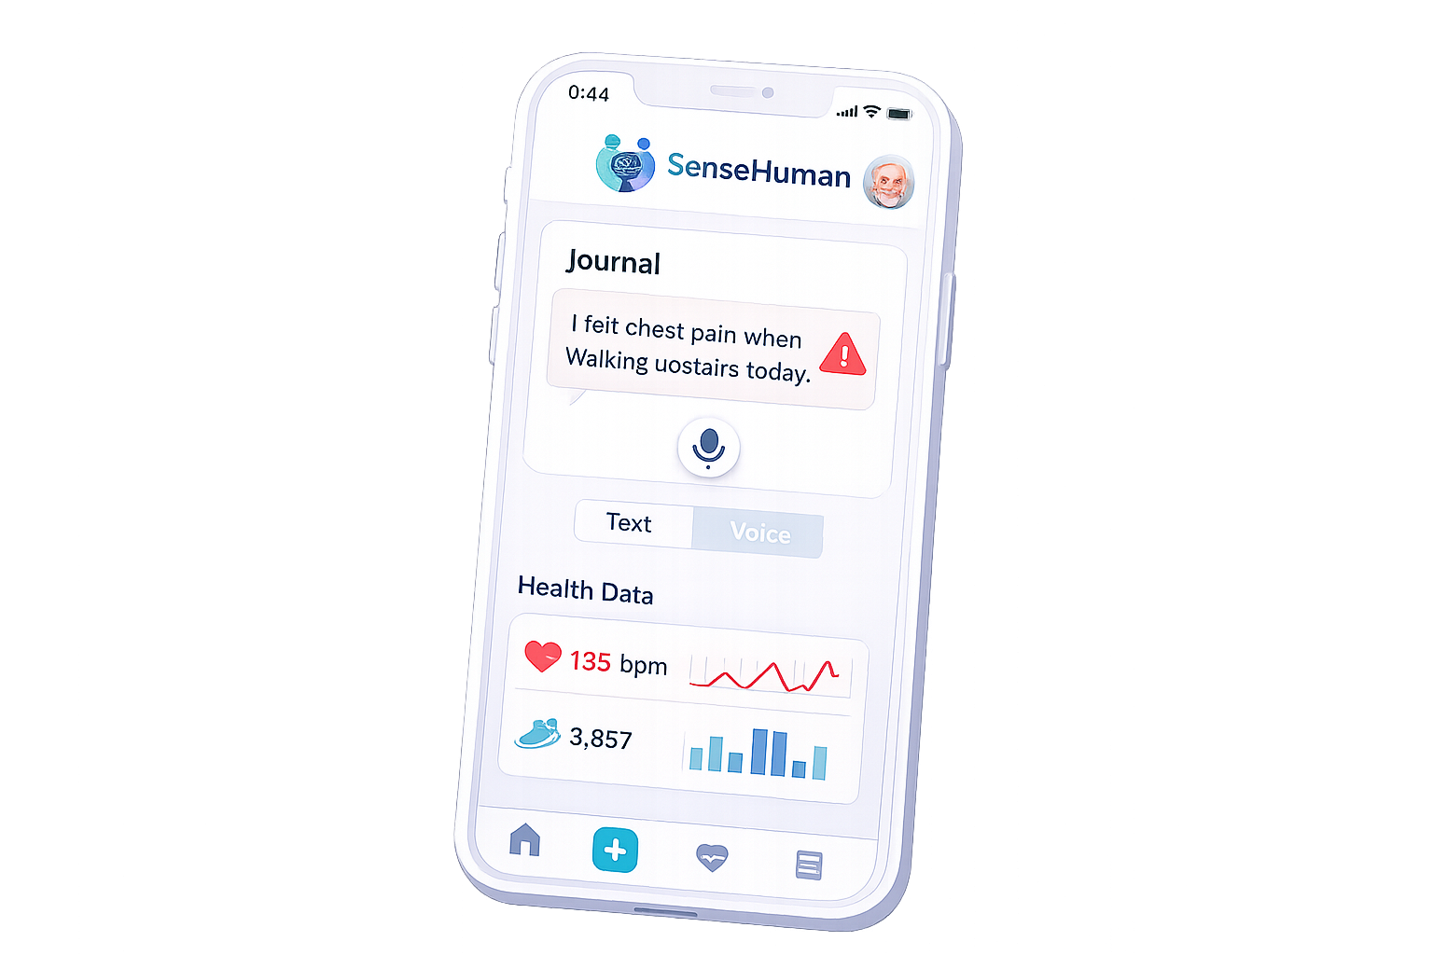
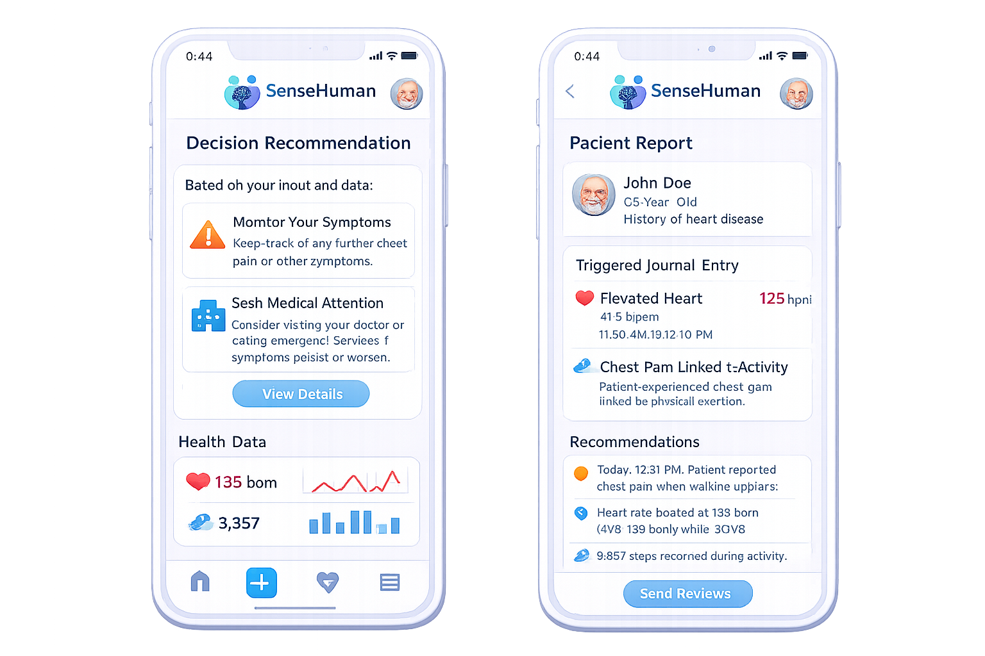
The Solution
Decision support system based on:
- how patients feel
- physiological meusurment

Slide 4
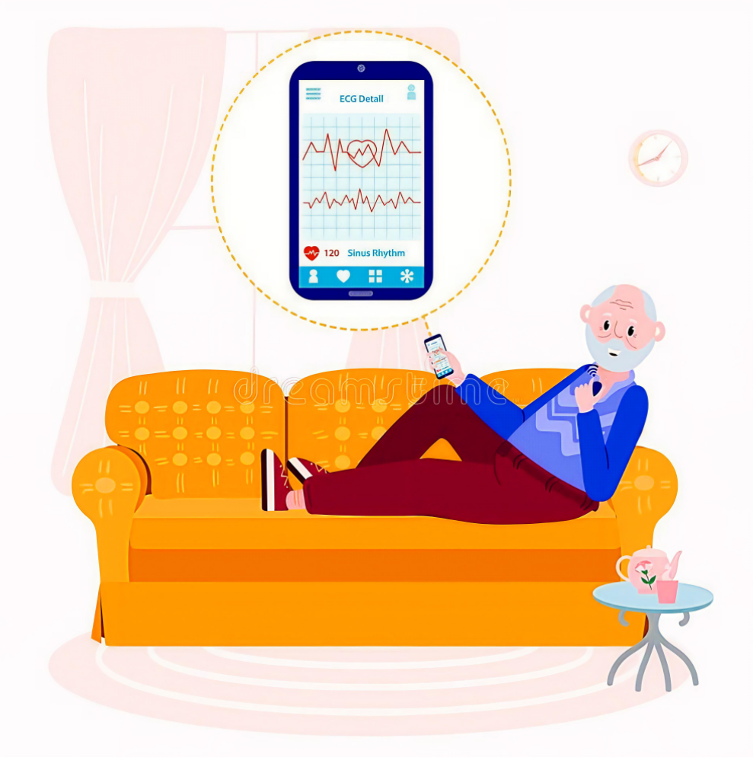
User Group: Patients
People with ongoing health conditions where symptoms can change over time
Users differ in age, tech experience and privacy comfort

Slide 5
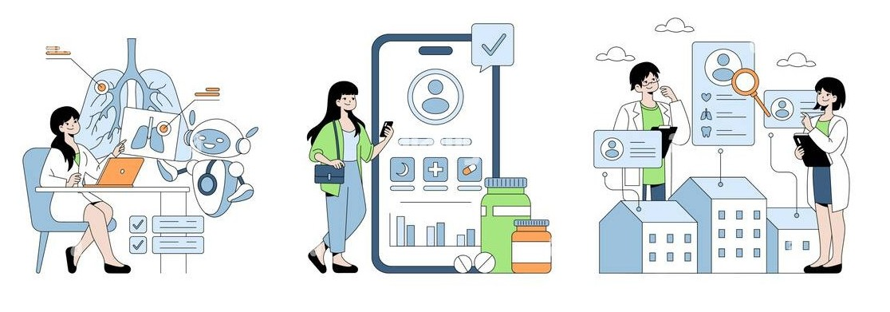
User Group: Healthcare Professionals
Doctors and nurses using the system output
Need clear, structured outputs
Patients need simplicity, clinicians need reliability

Slide 6
Theoretical perspectives
Domestication theory (Silverstone & Haddon, 1996)
Explains how technology becomes part of everyday life — not just one-time use
Relevant to SenseHuman because the system depends on regular use over time
Patients must see the system as useful and easy to fit into daily life
Success depends not only on technical accuracy, but also on trust, routine, and everyday integration

Slide 7
Theoretical perspectives
Domestication theory (Silverstone & Haddon, 1996)
Appropriation
  users must accept and see value in combining personal experiences with sensor data
Incorporation
  the system must fit naturally into their habits and routines
Objectification
  patients must see the app as easy to use and the sensors physically comfortable to wear
Conversion
  the system must share private experiences (e.g., pain or fatigue) and translate them into structured data that doctors can use

Slide 8
Theoretical perspectives
Participatory design aND USER INVOLVMENT
Designing with users, not only for users
Users should influence how the system is developed
Both patients and healthcare professionals have important knowledge
Their needs, routines, and concerns must shape the design

Slide 9
Why it matters for SenseHuman
Patients and healthcare professionals have different needs
Patients may want: simplicity, low effort, privacy, reassurance
Professionals may want: structure, reliability, clinical relevance
User involvement helps create a system that is useful, trusted, and realistic

Slide 10
Methodology: Study Design & Early Stages
Mixed-methods approach​
4 stages:​
    Interviews​
    Design workshops​
    Home study​
    Survey​
Goal: understand real-world use, not just usability​
Stage 1: Interviews​
    patients + healthcare professionals​
    Explore habits, needs, and concerns​
Stage 2: Workshops​
    Patients + professionals co-design system​
    Focus on combining symptoms + sensor data​
Notes:
This study uses a mixed-methods approach
It is structured in four stages: interviews, participatory design workshops, a home study, and a survey.
The goal is not only to test the system, but to understand how it works in real-life use.
First, we conduct interviews with patients and healthcare professionals to understand current practices, needs, and concerns.
Then, we run participatory design workshops where both groups work together to shape the system, especially how symptom reporting and sensor data should be combined.

Slide 11
Methodology: Real-World Testing & Evaluation
Stage 3: Home Study (3 weeks)
  Use prototype in daily life
  Wear sensor + record journal entries
  Observe routines, effort, and usefulness
Stage 4: Survey
  Evaluate:
    Usefulness
    Ease of use
    Trust
    User experience
Why this approach?
  Captures both:
    User experience (qualitative)
    Acceptance (quantitative)
  Shows how system works over time
Notes:
In the third stage, participants use the system in a three-week home study. They wear a sensor and record journal entries in their daily lives. This helps us understand how the system fits into routines over time, and whether it feels useful or demanding.
Finally, we use a survey to evaluate the overall experience, including usefulness, ease of use, trust, and satisfaction.
By combining these methods, we get both detailed user experiences and measurable patterns of acceptance. This allows us to understand not just how the system is designed, but how it is actually used in practice.

Slide 12

THANK you!
sahandkh@kth.se
marefi@kth.se
qusaiaha@kth.se
Kyliea@kth.se

